Slide 1
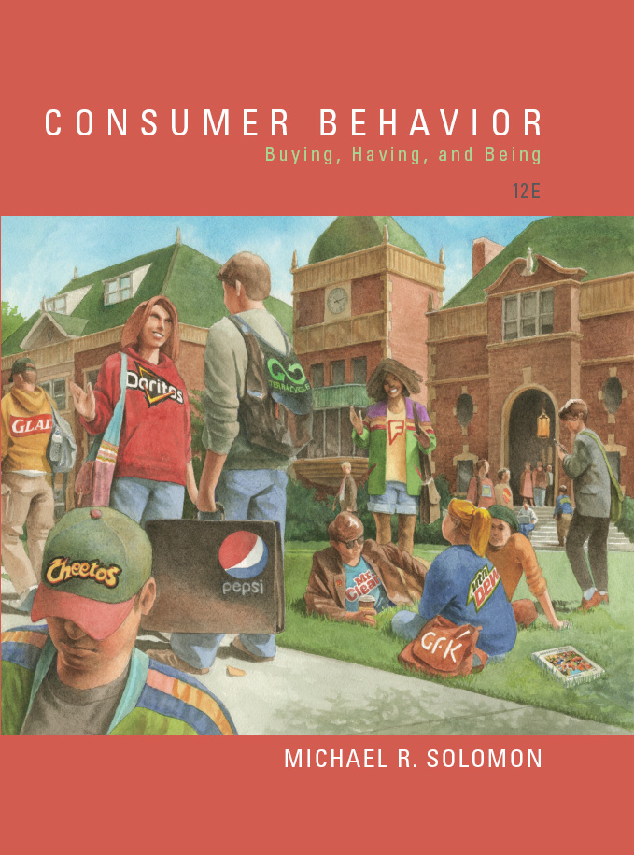
Consumer Behavior: Buying, Having, and Being
Twelfth Edition
Chapter 10
Buying, Using and Disposing
Copyright © 2017, 2015, 2013 Pearson Education, Inc. All Rights Reserved.
Notes:
If this PowerPoint presentation contains mathematical equations, you may need to check that your computer has the following installed:
1) MathType Plugin
2) Math Player (free versions available)
3) NVDA Reader (free versions available)
This chapter defines the scope of international business and introduces us to some of its most important topics.

Slide 2
Learning Objectives (1 of 2)
10.1 Many factors at the time of purchase dramatically influence the consumer decision-making process.
10.2 The information a store’s layout, Web site, or salespeople provides strongly influences a purchase decision.
10.3 The growth of a “sharing economy” changes how many consumers think about buying rather than renting products.

Slide 3
Learning Objectives (2 of 2)
10.4 Our decisions about how to dispose of a products are as important as how we decide to obtain it in the first place.

Slide 4
Learning Objective 10.1
Many factors at the time of purchase dramatically influence the consumer’s decision-making process
Notes:
There are many factors that affect our purchases, including emotion. For instance, Yankelovich Partners found that buying a car is the most anxiety-provoking retail experience for consumers.

Slide 5
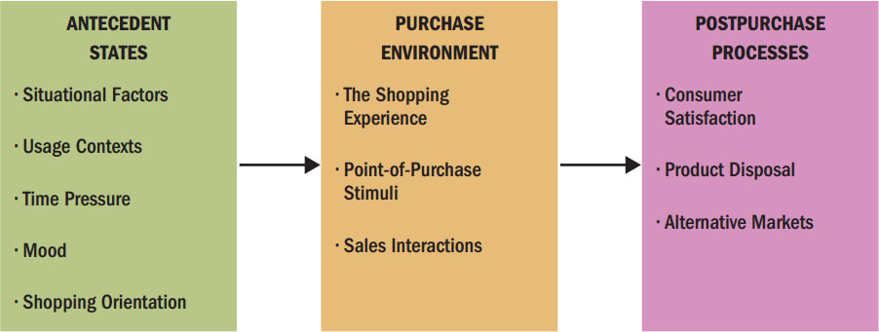
Purchase and Postpurchase Activities
A consumer’s choices are affected by many personal factors…and the sale doesn’t end at the time of purchase.
Figure 10.1 Issues Related to Purchase and Post purchase Activities
Notes:
Figure 10.1 illustrates that many contextual factors affect our choices. These might include mood, whether we feel time pressure to make a purchase, and the reason we need the product. Salespeople could play a role in our decisions, too.

Slide 6
Social and Physical Surroundings
Affect a consumer’s motives for product usage and product evaluation
Décor, odors, temperature
Co-consumers as product attribute
Large numbers of people = arousal
Interpretation of arousal: density versus crowding
Type of patrons
Notes:
A consumer’s physical and social environment affects her motives to use a product as well as how she will evaluate the item. These cues include the immediate environment and the type and number of other consumers who are there.
The sheer presence or absence of co-consumers is a product attribute. The presence of many people can increase physiological arousal levels so that our experiences seem more intense. Also, the type of consumers who are in a store affects our perceptions. We infer things about a store from the customers there.

Slide 7
Temporal Factors: Economic Time
Timestyle
Time Poverty
Notes:
Time is one of consumers’ most precious resources. We may change what we want to buy based on temporal influences like what time it is or how much time is left before we need the product. Economic time points out that time is an economic variable – think “time is money.” People’s priorities determine their timestyle. Your timestyle determines how you spend your time resource. Some people feel that they are time poor. That means that they simply feel that they do not have sufficient time. It may be just a perception because people actually have more time free from work than ever before, but there are just so many options now!

Slide 8
Temporal Factors: Psychological Time
Social
Temporal Orientation
Planning Orientation
Polychronic
Notes:
A study looked at how the timestyles of a group of American women influence their consumption choices. The researchers found four dimensions of time.
The social dimension refers to individuals’ categorization of time as either “time for me” or “time with/for others.”
The temporal orientation dimension depicts the relative significance individuals attach to past, present, or future.
The planning orientation dimension alludes to different time management styles varying on a continuum from analytic to spontaneous.
The polychronic orientation dimension distinguishes between people who prefer to do one thing at a time from those who multitask.

Slide 9

Five Perspectives on Time
Time is a _____.
Pressure cooker
Map
Mirror
River
Feast
Notes:
Those same researchers found that women viewed time in different ways and they developed five metaphors to capture how women viewed time.
Women who view time as a pressure cooker are analytical and monochronic. They usually feel like the are under pressure and they shop in a methodical manner.
Women who view time as a map are also analytical but they focus on the future and tend to multitask. They tend to engage in extensive information search and comparison shopping.
Women who view time as a mirror are analytical and polychronic but they have a past temporal orientation (as opposed to the time as a map women). These women are risk averse and they stick to brands they trust.
Women who view time as a river tend to be very spontaneous with a focus on the present. They go shopping on the spur of the moment.
Women who view time as a feast are analytical planners with a present focus. They view time as something that allows them to enjoy life. For this reason, they tend to seek out opportunities for hedonic consumption.

Slide 10
For Reflection (1 of 4)
In what ways do you experience time poverty? What products do you purchase because of the sense of time poverty?

Slide 11
Learning Objective 10.2
The information a store’s layout, Web site, or salespeople provides strongly influences a purchase decision.
Notes:
As consumers make decisions they are influenced by the situation they are in too.

Slide 12
The Shopping Experience
Focus groups
Total quality management (TQM)
Gemba
Notes:
Focus groups, in which a small set of consumers comes into a facility to try a new item while company personnel observe them from behind a mirror.
Total quality management (TQM) is a complex set of management and engineering procedures that aims to reduce errors and increase quality.
Gemba, which to the Japanese means “the one true source of information.”

Slide 13
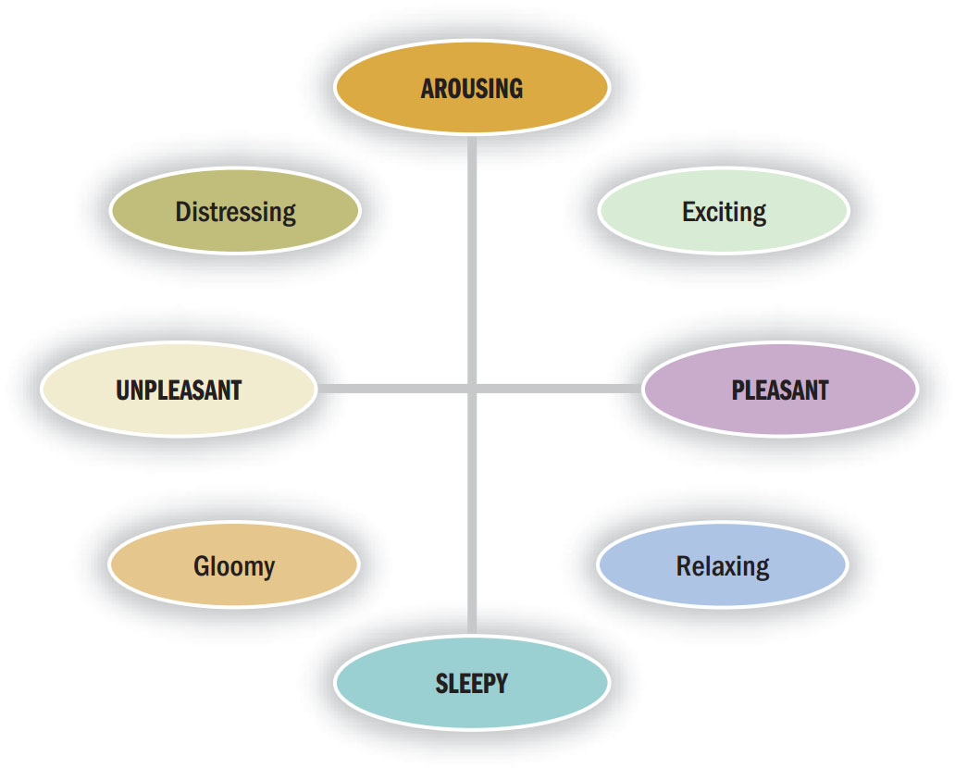
Figure 10.3 Dimensions of Emotional States
Notes:
The shopping experience is affected by how pleasant our environment is perceived and our level of arousal during the consumption experience. We can enjoy or not enjoy and feel stimulated or not. Clearly our mood can affect the experience. This figure illustrates the influence of the two basic dimensions of pleasure and arousal. Evaluations will be more positive when our mood state is positive.

Slide 14
Reasons for Shopping
Social experiences
Sharing of common interests
Interpersonal attraction
Instant status
The thrill of the hunt
Notes:
We can segment consumers in terms of their shopping orientation, or general attitudes about shopping. These orientations vary depending on the particular product categories and store types we consider. The motives for shopping are listed on the slide. Many people shop for the social benefits. Shopping areas are areas to hang out with friends and family. Stores frequently offer specialized goods that allow people with shared interests to communicate. Shopping centers are a natural place to congregate. Shopping may make people feel important. Some people pride themselves on their knowledge of the marketplace.

Slide 15
E-Commerce: Clicks versus Bricks
Benefits: good customer service, more options, more convenient
Limitations: lack of security, fraud, actual shopping experience, shipping charges
Notes:
The experience of acquiring the good may be quite different off line versus online. Electronic marketers can reach people anywhere but there are also issues as well. This slide lists the benefits and limitations on online retail sites.

Slide 16
Retailing as Theater
Landscape themes
Marketscape themes
Cyberspace themes
Mindscape themes
Notes:
Retail environments are important for attracting shoppers and keeping them in the stores. Innovative merchants use four kinds of theming techniques. These are listed on the slide.
Landscape themes rely on associations with images of nature, animals, and the physical body. Bass Pro Shops is an example of a landscape theme.
Marketscape themes build on associations with man-made places. The Venetian Hotel in Las Vegas is an example of a marketscape.
Cyberspace themes build on information and communications technology. eBay uses this approach.
Mindscape themes draw on abstract ideas and concepts, fantasy, and often possess spiritual overtones. Day spas might reflect a spiritual theme.

Slide 17
Store Image: The Store’s Personality
Location + merchandise suitability + knowledge/congeniality of sales staff
Other intangible factors affecting overall store evaluation:
Interior design
Types of patrons
Return policies
Credit availability
Notes:
Stores can have very clear personalities. We can refer to the store personality as store image. Some of the important dimensions of a store’s image are location, merchandise suitability, and the knowledge and congeniality of the sales staff. Intangible factors like interior design, the types of people seen in the store, and store return policies can also influence store image.

Slide 18
In-Store Decision Making
Mental budgets
Unplanned buying
Impulse buying
Point-of-purchase (POP) stimuli
Notes:
Mental budgets for grocery trips are typically composed of both an itemized portion and in-store slack. This means they typically decide beforehand on an amount they plan to spend, but then
they have an additional amount in mind (slack) they are willing to spend on unplanned purchases—if they come across any they really want to have.
That
A POP can be an elaborate product display or demonstration, a coupondispensing machine, or an employee who gives out free samples of a new cookie in the grocery aisle.

Slide 19
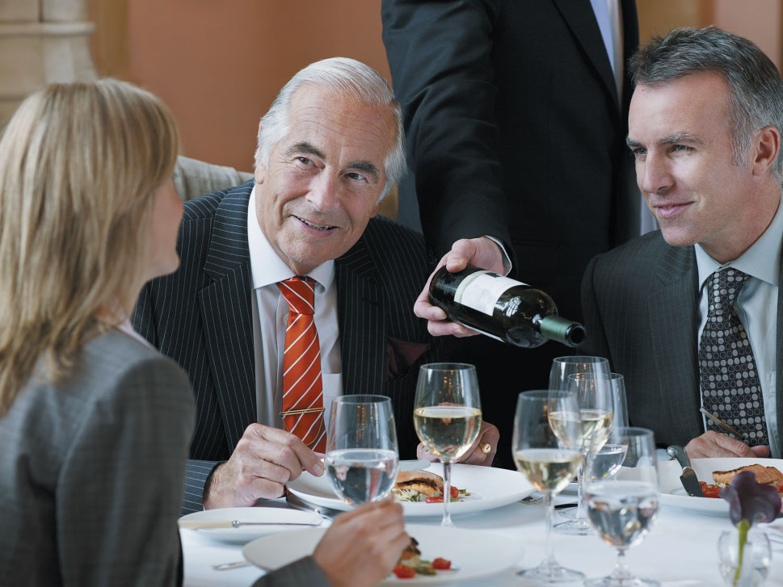
Salespeople Play a Key Role
Notes:
A buyer-seller situation is like many dyadic encounters. During the relationship, the parties establish their own roles in the relationship through identity negotiation. Salespeople can be more effective if they have authority and expertise, and even if they have incidental similarities, such as a shared experience, to the buyer.

Slide 20
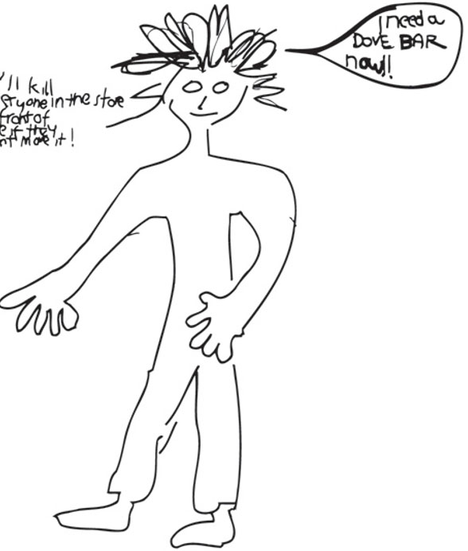
For Reflection (2 of 4)
How would you depict an impulse buyer?
Explain.
Notes:
An image shown in the book is a drawing of how one consumer depicted an impulse buyer. How would you depict yourself as an impulse buyer?

Slide 21
Learning Objective 10.3
The growth of a “sharing economy” changes the way many consumers think about buying rather than renting products.
Notes:
This chapter opens with the story of Zachary. Zachary leads a secret life. During the week he is a stock analyst, but on the weekends, he’s out on the road with his Harley-Davidson. Zachary’s group of biker friends is an important part of his identity and this membership influences many buying decisions. The biker group is a reference group. A reference group is an actual or imaginary individual or group conceived of as having significant relevance upon an individual’s evaluations, aspirations, or behavior.

Slide 22
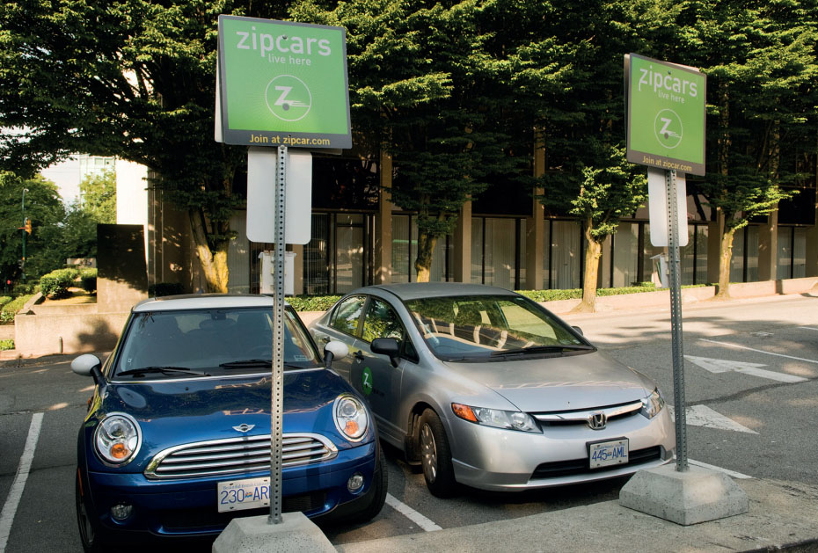
Ownership and the Sharing Economy
Sharing economy
Collaborative consumption
P2P commerce (peer-to-peer)

Slide 23
For Reflection (3 of 4)
What are some items that you “share” with your peers?

Slide 24
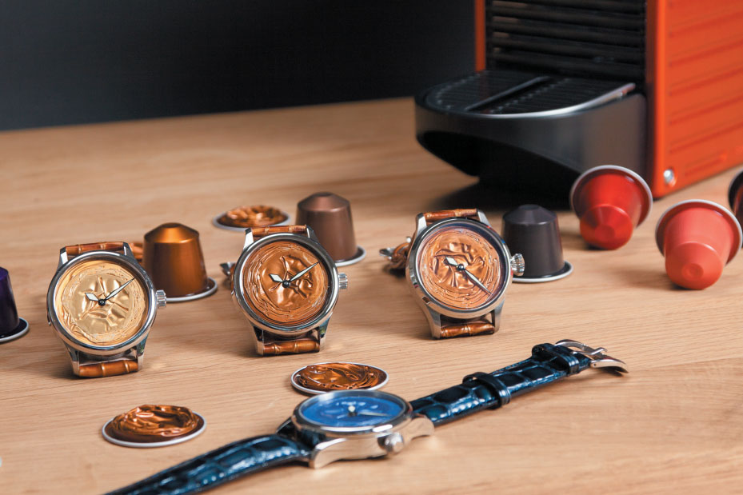
Learning Objective 10.4
Our decisions about how to dispose of a product are as important as how we decide to obtain it in the first place.

Slide 25
Postpurchase Satisfaction
Consumer satisfaction/dissatisfaction (CS/D)
Expectancy disconfirmation model
Notes:
Our overall reactions to a product after we’ve bought it—what re-searchers call consumer satisfaction/dissatisfaction (CS/D)— obviously play a big role in our future behavior.
According to the expectancy disconfirmation model, we form beliefs about product performance based on our prior experience with the product or communications
about the product that imply a certain level of quality.

Slide 26
Product Disposal
Recycling
Lateral cycling
Underground economy
Recommerce
Swishing
Notes:
During lateral cycling, one consumer exchanges something he or she owns for something the other person owns.
The underground economy in the form of flea markets and other used-product sales formats is a significant element in the U.S. market.
The new trend of recommerce (a play on the term e-commerce) shows that many consumers want to squeeze more value out of their possessions by selling or trading
Them. This focus has given birth to the swishing movement, where people organize parties to exchange clothing or other personal possessions with others.

Slide 27
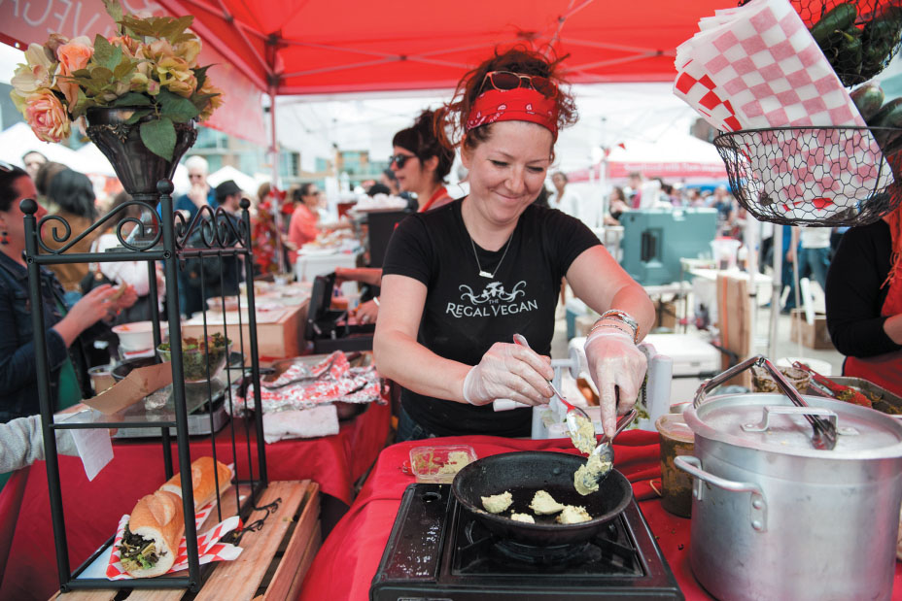
Underground Economy
The underground economy in the form of flea markets and other used-product sales formats is a significant element in the U.S. market.

Slide 28
For Reflection (4 of 4)
What items have you purchased from the underground ecomomy?
How do you feel postpurchase if you know you can recycle the product?

Slide 29
Chapter Summary (1 of 2)
Many factors affect the consumer decision-making process.
The retail environment and experience is a strong influence.
Marketers need to understand behavior in collective decision-making situations.
The decision-making process differs when people choose what to buy on behalf of an organization rather than for personal use.
Notes:
We’ve reviewed many concepts in this chapter. The key points are noted on the slide.

Slide 30
Chapter Summary (2 of 2)
The growth of a “sharing economy” changes how many consumers think about buying rather than renting products.
Our decisions about how to dispose of a products are as important as how we decide to obtain it in the first place.

Slide 31

Copyright

